Slide 1




Spring MVC
Web Applications with Spring MVC, JPA and MySQL
Spring MVC
SoftUni Team
Technical Trainers
Software University
http://softuni.bg

Slide 2

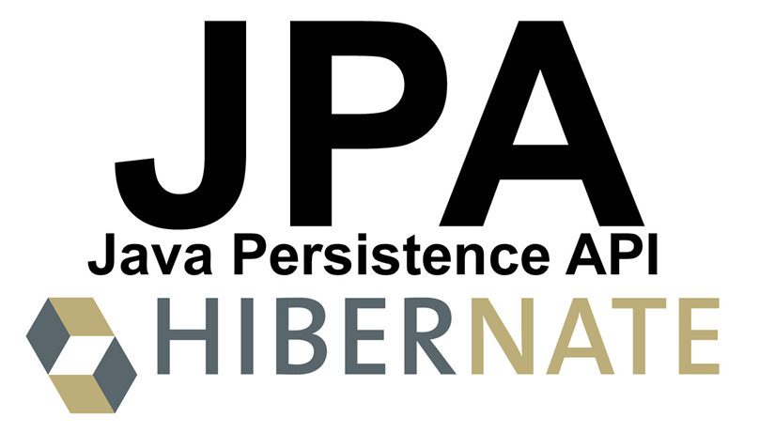
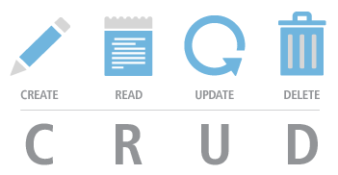
Table of Contents
Spring Framework and Spring MVC Overview
Creating Controllers
Creating Views
Data-Driven Web Apps with Spring MVC + JPA
Creating Models with JPA
CRUD Operations: View / Create / Edit / Delete Data

Slide 3
Have a Question?
sli.do #2225

Slide 4
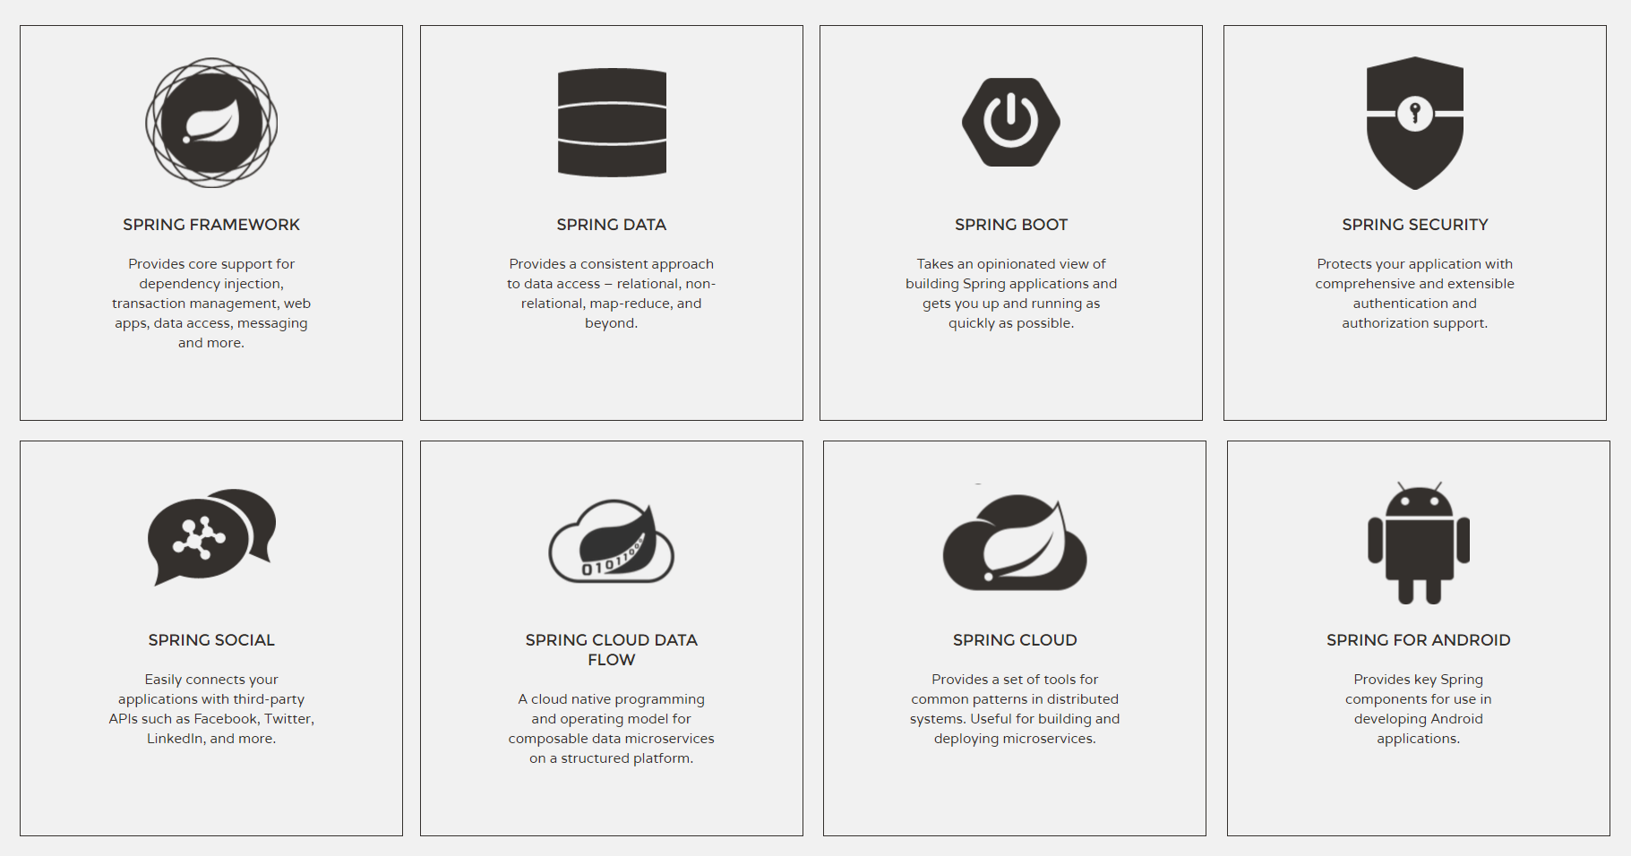
Spring Framework

Slide 5
Spring Framework – Components
Spring Framework
Open-source platform for modern Java-based enterprise apps
Spring Core
IoC container (inversion of control) – dependency injector
Spring Data
Simplifies data access: JPA, relational / NoSQL databases, cloud
Spring MVC
MVC-based framework for Web apps and REST services
Spring Boot
Simplifies Spring development: quick start with less coding

Slide 6
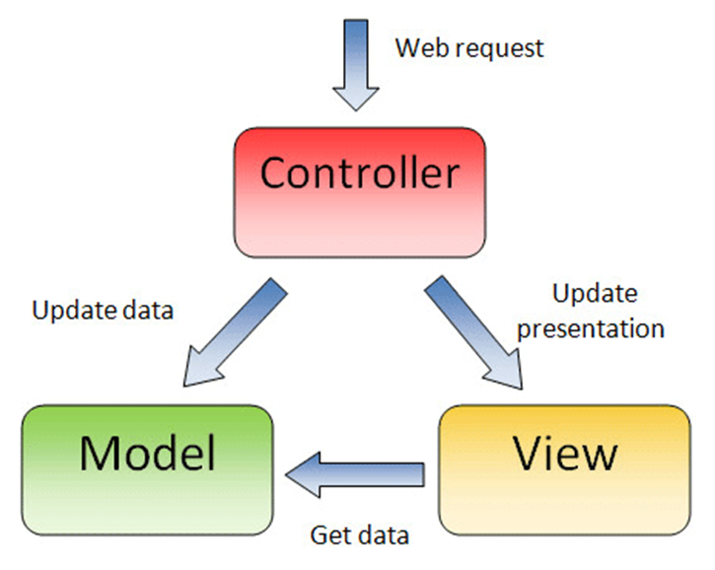
What is Model-View Controller (MVC)?
MVC == Model-View-Controller
Views (presentation / UI)
Render UI (produce HTML)
Controllers (logic)
Prepare UI (presentation logic)
Update database (business logic)
Models (data)
Data access classes or ORM

Slide 7
Starting with Spring MVC (Maven Project)
pom.xml
<parent>
<groupId>org.springframework.boot</groupId>
<artifactId>spring-boot-starter-parent</artifactId>
<version>1.4.0.RELEASE</version>
</parent>
<dependencies>
<dependency>
<groupId>org.springframework.boot</groupId>
<artifactId>spring-boot-starter-thymeleaf</artifactId>
</dependency>
</dependencies>
<properties><java.version>1.8</java.version></properties>
Inherit "spring-boot-starter-parent"
Include the Spring MVC + Boot + Thymeleaf libraries
Use Java 8

Slide 8
Spring Boot Application Class
src/main/java/app/MvcAppExample.java
package app;
import org.springframework.boot.*;
import org.springframework.boot.autoconfigure.*;
@SpringBootApplication
public class MvcAppExample {
public static void main(String[] args) {
SpringApplication.run(MvcAppExample.class, args);
}
}
Using a package is obligatory!
Configure the Spring Boot app
Run the Spring Framework app

Slide 9
Controllers
MVC controllers hold actions, mapped to URL by annotations
src/main/java/app/controllers/HomeController.java
@RestController
public class HomeController {
@RequestMapping("/")
public String home() {
return "Hello Spring Boot";
}
@RequestMapping("/date")
public String date() { return new Date().toString(); }
}
REST controllers have no view, just return data
Action mapped to http://localhost:8080/
Mapped to http://localhost:8080/date

Slide 10
Web Controller Example
Create Web controller + action /hello + view hello.html
src/main/java/app/controllers/HelloController.java
@Controller
public class HelloController {
@RequestMapping("/hello")
public String hello(Model model) {
model.addAttribute("msg",
"Hello Spring MVC + Thymeleaf");
return "hello";
}
}
Web MVC controllers return view / redirect
Prepare data for the view in its model
Render the "hello" view: /src/resources/templates/hello.html

Slide 11
Views
Views render the HTML: combine logic (e.g. loops) with HTML
Spring MVC supports many view engines, like JSP and Thymeleaf
src/main/resources/templates/hello.html
<!DOCTYPE html>
<html xmlns:th="http://www.thymeleaf.org">
<head><title>Hello, Thymeleaf</title></head>
<body>
Message from the model: <span th:text="${msg}" />.
</body>
</html>
Define a Thymeleaf view
Display property:
model.msg

Slide 12
Project Auto-Reload on Change
Disable Thymeleaf caching for the view templates
Install spring-boot-devtools in your Maven configuration
Recompile after each project change: [Ctrl+F9] in IntelliJ IDEA
src/main/resources/application.properties
spring.thymeleaf.cache = false
pom.xml
<dependency>
<groupId>org.springframework.boot</groupId>
<artifactId>spring-boot-devtools</artifactId>
</dependency>

Slide 13
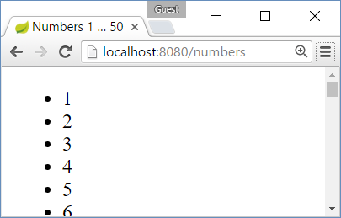
Example: Print the Numbers 1…50
Create an action /numbers + view numbers.html
HelloController.java
templates/numbers.html
@Controller
public class HelloController {
@RequestMapping("/numbers")
public String numbers() {
return "numbers";
}
}
…
<ul><li th:each="i : ${#numbers.sequence(1, 50)}"
th:text="${i}" /></ul>
…

Slide 14
Example: Greeting Controller
Create an action /greeting to say hello to its parameter "name"
src/main/java/app/controllers/GreetingController.java
package app.controllers;
@Controller
public class GreetingController {
@RequestMapping("/greeting")
public String greeting(@RequestParam(value="name",
defaultValue="unknown") String name, Model model) {
model.addAttribute("name", name);
return "greeting";
}
}
Take a HTTP GET request parameter named "name"
Put the name into the model and render view "greeting.html"

Slide 15
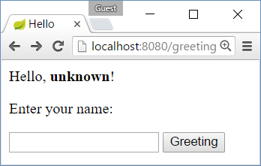
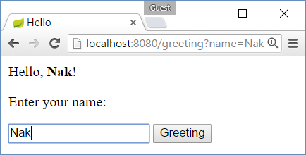
Example: Greeting View
Create a view to say hello to its model property "name"
src/main/resources/templates/greeting.html
<!DOCTYPE html>
<html xmlns:th="http://www.thymeleaf.org">
…
Hello, <b><span th:text="${name}" /></b>!
<form>
Enter your name:
<input type="text" name="name"/>
<input type="submit" />
</form>
…
Greeting to ${name}
HTML form to submit name

Slide 16
Creating Simple Spring MVC App
Create new Maven project in your IDE
Add dependences in pom.xml to Spring Boot + Spring MVC + Thymeleaf
Create the Spring Boot application class: @SpringBootApplication
Create REST controller + actions: / shows "hello"; /date shows the date
Create Web controller + action + view: /hello shows "hello" (use model)
Configure auto-reload on change: application.properties + pom.xml
Create action + view: /numbers to prints the numbers 1 ... 50
Create action + view: /greeting?name=Peter to greet Peter
Live Exercise in Class (Lab)

Slide 17
Defining a Layout with Thymeleaf
src/main/resources/templates/fragments/layout.html
<!DOCTYPE html>
<html xmlns:th="http://www.thymeleaf.org">
<head th:fragment="head">
<title th:if="${pageTitle}" th:text="${pageTitle}" />
</head>
<body>
<header th:fragment="header">Site Header …</header>
<main th:fragment="main">Main Fragment</main>
<footer th:fragment="footer">&copy; My Footer</footer>
</body>
</html>

Slide 18
Including Fragments from the Layout
src/main/resources/templates/main.html
<!DOCTYPE html>
<html xmlns:th="http://www.thymeleaf.org">
<head th:include="fragments/layout :: head"
th:with="pageTitle='Main Page with Layouts'" />
<body>
<header th:include="fragments/layout :: header" />
<main>
<h1>Main Page</h1>
<p>The main page content comes here …</p>
</main>
<footer th:include="fragments/layout :: footer" />
</body>
</html>

Slide 19
Example: List Files
Create an action Files to show the folders and files in C:\
controllers/FilesController.java
templates/files.html
@RequestMapping("/files")
public String files(Model model) {
File path = new File("c:\\");
File[] allFiles =
path.listFiles();
model.addAttribute(
"allFiles", allFiles);
return "files";
}
<h1>Files</h1>
<div th:each =
"file : ${allFiles}"
th:text = "${file.name}">
</div>

Slide 20
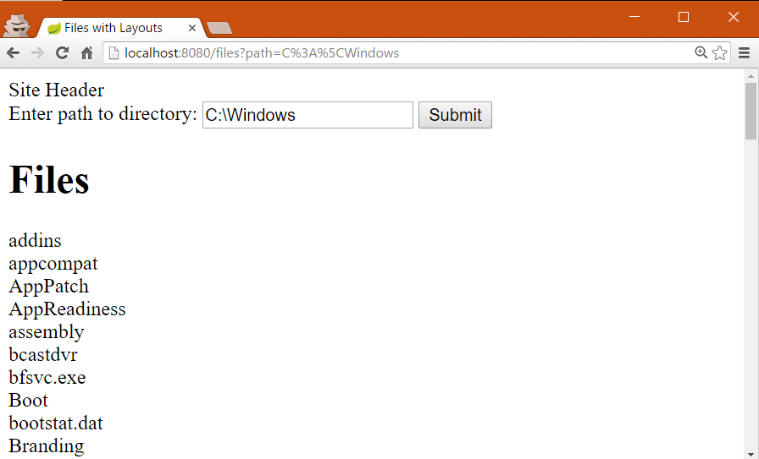
Example: List Files in Specified Folder

Slide 21
Solution: List Files in Specified Folder
controllers/FilesController.java
templates/files.html
@RequestMapping("/files")
public String files(
@RequestParam(value = "path",
defaultValue = "c:\\")
String path, Model m) {
m.addAttribute("path", path);
File[] allFiles =
new File(path).listFiles();
m.addAttribute(
"allFiles", allFiles);
return "files";
}
<form>
Enter path to directory:
<input type="text"
name="path"
th:value="${path}" />
<input type="submit" />
</form>
<h1>Files</h1>
<div th:each="f : ${allFiles}">
<a th:text="${f.name} th:href ="@{/files(path=${f.path})}" />
</div>

Slide 22
Data-Driven MVC Apps
Data-driven web applications
List data from database
CRUD operations over the data
Spring MVC has integration with JPA and Hibernate
Use Spring Data JPA

Slide 23
Configure Spring Data JPA with Maven
pom.xml
<dependencies>
…
<dependency>
<groupId>org.springframework.data</groupId>
<artifactId>spring-data-jpa</artifactId>
</dependency>
<dependency>
<groupId>mysql</groupId>
<artifactId>mysql-connector-java</artifactId>
</dependency>
</dependencies>

Slide 24
Defining Entity Classes
src/main/java/app/entities/User.java
@Entity @Table(name = "users")
public class User {
@Id @GeneratedValue(strategy = GenerationType.IDENTITY)
private Long id;
@Column(nullable = false, length = 30, unique = true)
private String username;
@Column(length = 60)
private String passwordHash;
@Column(length = 100)
private String fullName;
}
Don't forget to generate getters / setters / constructors / toString()

Slide 25
Defining Repository Classes
src/main/java/app/repositories/UserRepository.java
public interface UserRepository
extends JpaRepository<User, Long> {
List<User> findByUsername(String username);
}
The implementation will be auto-generated by Spring Data JPA

Slide 26
Database Settings
src/main/resources/application.properties
spring.datasource.driver-class-name = com.mysql.cj.jdbc.Driver
spring.datasource.url = jdbc:mysql://localhost/blog_db?characterEncoding=utf8
spring.datasource.username = root
spring.datasource.password =
# Configure Hibernate DDL mode: create / update
spring.jpa.properties.hibernate.hbm2ddl.auto = create

Slide 27
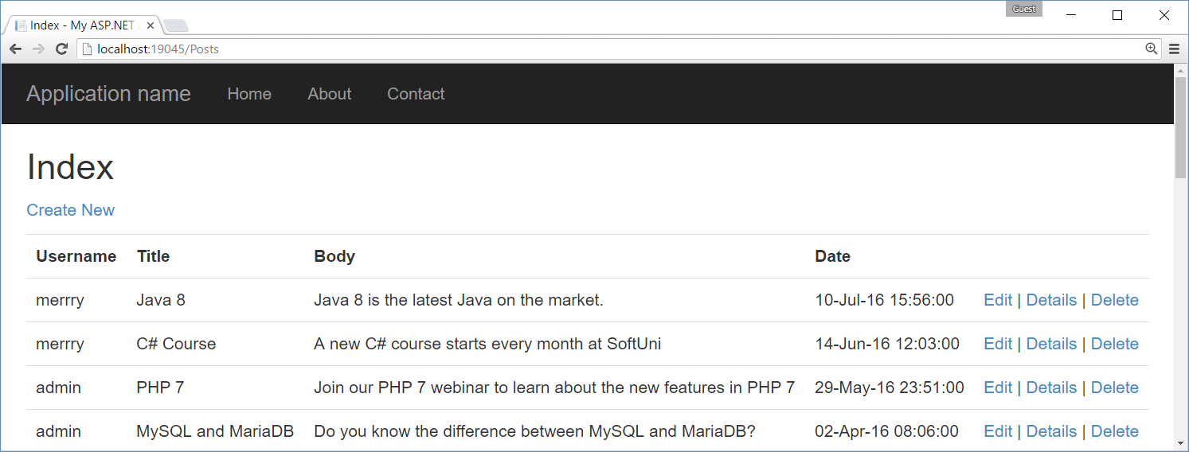
CRUD with Spring MVC + Spring Data
Live Exercise in Class (Lab)

Slide 28

Summary
Spring MVC is powerful Web development platform
Views render HTML code
Controllers process HTTP GET / POST actions
Integration with databases and JPA
Message from the model:
<span th:text="${msg}" />.
public String files(
@RequestParam(value = "path",
defaultValue = "c:\\")
String path, Model model) { … }

Slide 29








Spring MVC
https://softuni.bg/courses/software-technologies

Slide 30
License
This course (slides, examples, demos, videos, homework, etc.) is licensed under the "Creative Commons Attribution-NonCommercial-ShareAlike 4.0 International" license

Slide 31






Free Trainings @ Software University
Software University Foundation – softuni.org
Software University – High-Quality Education, Profession and Job for Software Developers
softuni.bg
Software University @ Facebook
facebook.com/SoftwareUniversity
Software University @ YouTube
youtube.com/SoftwareUniversity
Software University Forums – forum.softuni.bg

